Slide 1
DANA 4840
Classification II
Part II Partitional Clustering
Part 2 – Assessing Cluster Tendency

Slide 2
Should we cluster?
Before working on a cluster analysis project, we should ask ourselves: Should we cluster?
If the answer is yes, we then ask: How many clusters? before performing partitional clustering (you will learn that we can find k using elbow method, silhouette approach or gap statistics later this term).

Slide 3
Assessing cluster tendency
To determine if we should cluster (that is, assess cluster tendency), we can make use of two approaches:
Use of Hopkins statistic
Use a visual approach called VAT (which stands for Visual assessment of cluster tendency)

Slide 4
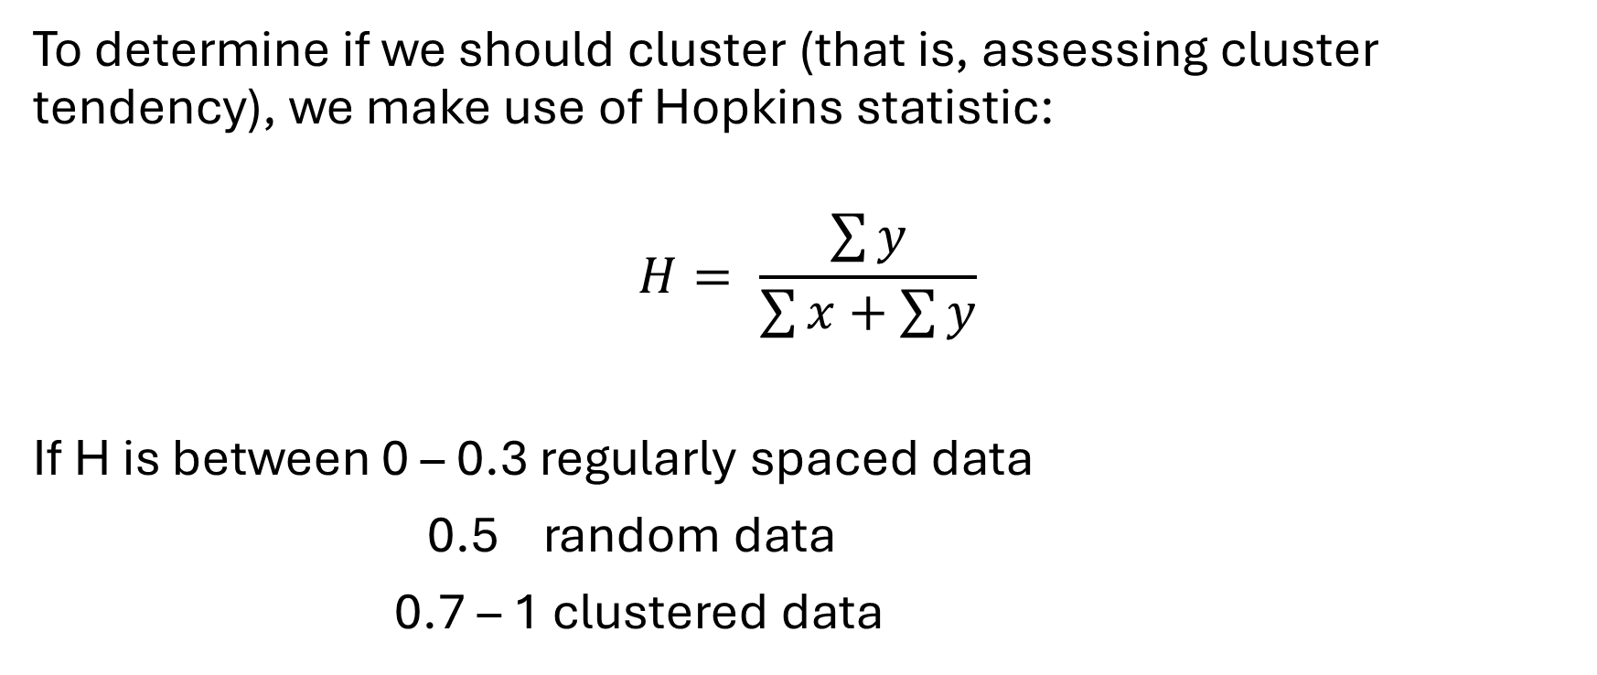
Hopkins statistic
To determine if we should cluster (that is, assessing cluster tendency), we make use of Hopkins statistic:
$$H= \frac{\sum{y}}{\sum{x}+\sum{y}}$$
If H is between 0 – 0.3 regularly spaced data
0.5 random data
0.7 – 1 clustered data

Slide 5

Hopkins statistic
Students to draw a diagram to illustrate meaning of $\sum{x}$ and $\sum{y}$:
Students should work on the worksheet on Hopkins statistic to understand how to run R commands to obtain Hopkins statistics. Compare hopkins() command in clustertend package and Hopkins() command in hopkins package (see worksheet). Factoextra package also has get_clust_tendency() command (see R code notes).

Slide 6
VAT (Visual assessment of cluster tendency)
Students should try the command fviz_dist() in factoextra package (see R code notes) to be aware there is a visual approach to assess cluster tendency. Students are expected to try both Hopkins statistics approach and visual approach if relevant for projects.

